Slide 1

Year 4 Meeting 2023
Led by: Mrs Herescu

Slide 2
Today we will be covering:
Staff in the year group
Topics for this year
Uniform reminders inc. PE kit
Homework expectations
Experiences planned for the year
Attendance
Multiplication Check

Slide 3
Staff
In Year 4 the following staff will be working with your child:
Mrs Herescu - Year lead/ 4H Teacher
Mrs Alexander – 4A Teacher
Ms Smith LST
Mrs S Jeacock – HLTA – PPA cover
Mrs W Vanhegan – HLTA – PPA cover

Slide 4


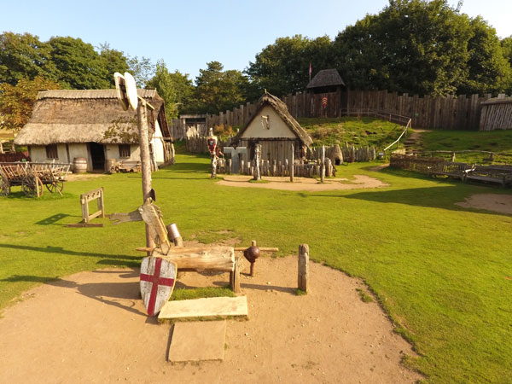
Historical landmarks – Tower of London
Spanish enrichment day
History off the page – Greeks
Museum of Power-Maldon
Mountfitchet castle
Woodland walk – Belhus woods
Topics
Notes:
Invasion - This project teaches children about life in Britain after the Roman withdrawal. Children will learn about AngloSaxon and Viking invasions up to the Norman conquest.
Misty Mountain, Winding River - This project teaches children about the characteristics and featur rivers and mountain ranges around the world, includi detailed exploration of the ecosystems and processe shape them and the land around them
Ancient Civillisations - This project teaches children about the history of three of the world’s first ancient civilisations: ancient Sumer, ancient Egypt and the Indus Valley civilisation. Children will learn about the rise, life, achievements and eventual end of each civilisation.

Slide 5
Uniform
Grey skirt or pinafore or grey trousers
Navy jumper, cardigan or sweatshirt (available with school logo)
White blouse/polo top/shirt
White or grey socks or tights
Navy school logo fleece
Black shoes
Blue gingham (checked) dress in summer
Please replace branded items with the new logo as children grow out of their clothes.

Slide 6
Uniform continued
PE uniform
P.E. clothing is a white t-shirt and black shorts.
For outdoors: black, navy or grey jogging bottoms/sweatshirt/tracksuit (not patterned inc. large writing) and black trainers.
All PE kit stays in school in a labelled bag.
Jewellery
Children may wear a watch to school (older year groups-not able to receive text messages etc).
Only small stud or sleeper earrings are acceptable for children with pierced ears.
During P.E. lessons we expect your child to remove studs, or cover with medical tape. This is the requirement laid down by the Education Authority.
No other jewellery is allowed.
Please encourage your child to leave their mobile phone at home- they cannot be used in the school grounds. If you are collecting them, there is no reason for mobiles to be with them.
All items are brought into school at your own risk.

Slide 7
PE days
4H – Monday, Thursday and Friday
4A – Monday, Wednesday and Thursday

Slide 8




Homework Expectations
Maths and English tasks set on Mirodo.
Daily reading (at least five times per week) through Reading Plus or their Oxford Reading Tree book
Timetables Rockstars – Daily
Passwords will be resent home soon.
Notes:
Discuss and explain the homework we set as a school.
Explain why it is important – to build upon learning
Explain importance of reading for pleasure AND Reading Plus as a tool to build not just fluency but comprehension
TTRS – Relate to expectation of all Year 4s knowing up to 12 x 12 and the impact on maths fluency.

Slide 9
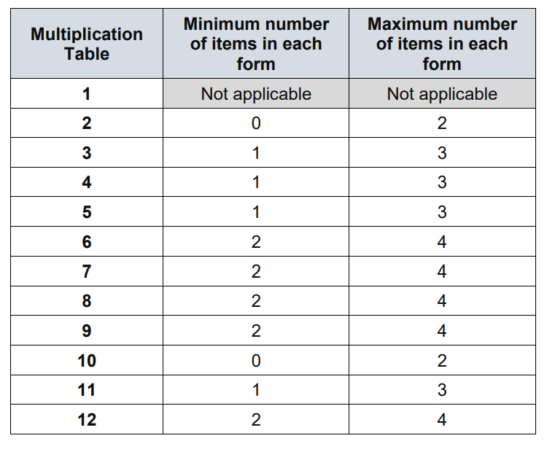
Multiplication Check
All Year 4 children take part.
25 Questions.
6 seconds per questions.
Up to 12 x 12.
Please support practice through TTRS.

Slide 10
What will happen to the results?
Schools will be provided results of each pupil. ​
This will determine extra support and any changes that need to be made in teaching. ​
National figures will be reported. ​
You will be informed of your child’s score via the end of year report.

Slide 11
Experiences
Term | Event
Autumn | Tower of London
Spring | Museum of Power - Maldon
Summer | Mountfitchet Castle
Notes:
Explain trips, including costings from the previous year. Discuss the importance of these trips/events and how they impact learning.

Slide 12
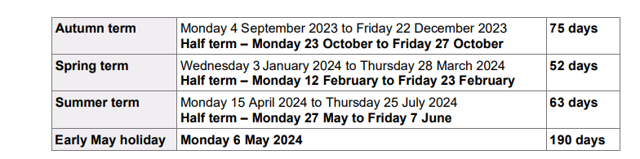
Attendance
Percentage | Number of Days in School | Number of Days Missed
100% | 190 | 0
96% | 183 | 7
95% | 181 | 9
90% | 171 | 19

Slide 13
Percentage | Days | Value
100% Attendance​ | 0 days missed​ | Gives your child the best opportunity to make great progress. ​
95% Attendance​ | 9 days’ absence or 1 week and 4 days of missed learning.​
90% Attendance​ | 19 days’ absence or 3 weeks and 4days of missed learning.​ | Makes it harder to learn and progress.Gaps in learning will be evident.​
85% Attendance​ | 29 days’ absence or 5 weeks and 4days of missed learning. Almost one half-term missed.​ | Will impact your child’s progresssignificantly.​
80% attendance​ | 38 days’ absence or 7 weeks and 3days of missed learning.​ | Seriously impacts your child’s learning and development.​
75% Attendance​ | 48 days’ absence or 9 weeks and 6days of missed learning.​
If your child has 90% attendance they will miss the equivalent of:
½ day per week
19 days a year
247 days over the 13 statutory years of education or 1 year and 10 weeks.

Slide 14
Punctuality
School opens at 8:40am. Gates close at 8:50. All children arriving after 8:50am will be marked late.
Punctuality is really important:
- we all feel flustered if we are late- children do too.
everyone else is already settled and it makes it difficult to join part way through a lesson.
missing parts of lessons create gaps in learning.

Slide 15
Attendance Process
Children are expected to attend school every day unless they are unwell.
If they are unwell, it is their parent's responsibility to inform the school by 9am, stating the reason for absence.
To ensure the safety of all our pupils, if we have not been notified of a reason for absence, we will call you. If we can't make contact, a member of staff will visit your home.
Due to the reasons outlined in the previous slides- if the child's attendance is not at least 96%, school will contact you so we can work together to improve attendance.
Please plan routine appointments outside the school day wherever possible.
The DFE have released new guidance regarding attendance, holidays will continue to be unauthorised and may result in a fine.

Slide 16
Parent Workshops
​
Over the course of the year, we will be offering a variety of parent workshops and drop-in sessions. These will be on a variety of subjects and topics to help you in supporting your child.
The dates and topics will be published on the newsletter, website and social media channels.

Slide 17
Additional Information
All policies can be found on the school website. Key Information > Policies.
Any problems or concerns, please speak to the class teacher in the first instance.
There are many ways we can support children and their families so if you have any concerns, please let us know.

