Slide 1

KS2 Reading Workshop

Slide 2
Overarching aim for English
Read easily, fluently and with good understanding
Develop the habit of reading widely and often, both for pleasure and information
Acquire a wide vocabulary, understanding of grammar and knowledge of linguistic conventions
Appreciate our rich and varied literary heritage

Slide 3
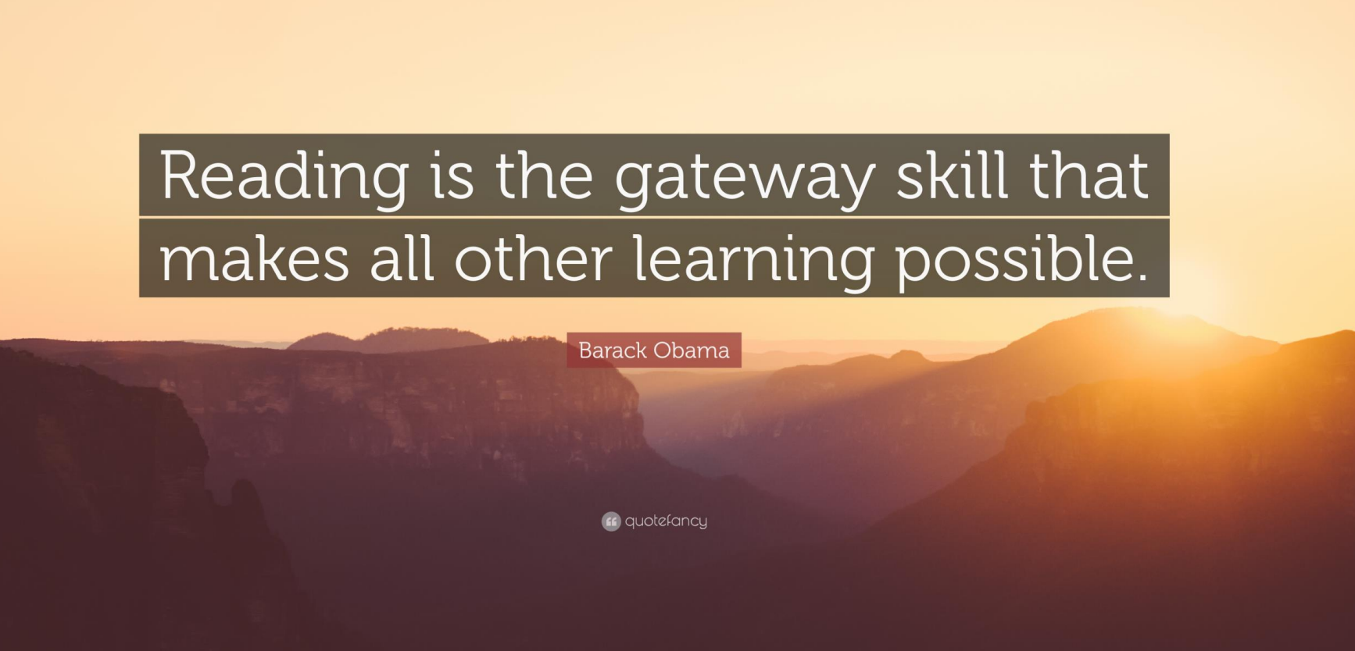

Slide 4
A love of reading…
ALL children are exposed to quality literature regardless of reading ability
Exposure to variety of vocabulary and texts that they might not have chosen themselves
ALL children have an opportunity to explore a range of genres
Debate and challenge of views of others
Foster a love of listening to a story

Slide 5
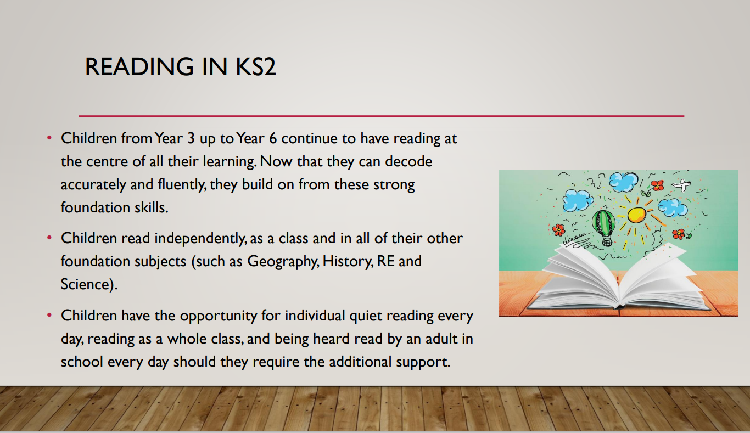

Slide 6
Whole class quality texts for all children
Daily Whole Class Reading sessions of 25 minutes for KS1 and 30 minutes for KS2
Dedicated weekly session on comprehension focussing on the class text – exploring language, literacy features, writer’s viewpoint, social and cultural themes, overall effects on the reader

Slide 7

WHOLE CLASS READING • Whole Class Reading is the lesson in which children in KS2 study specific texts and extracts from high quality books to learn and refine their skills in reading and comprehension.
• Children use the 'Reading Dogs' framework to help break down the individual skills required to read and comprehend a text fully.
• These skills are taught individually and build up over time throughout Key Stage 2, until children can read and comprehend fully and independently.

Slide 8
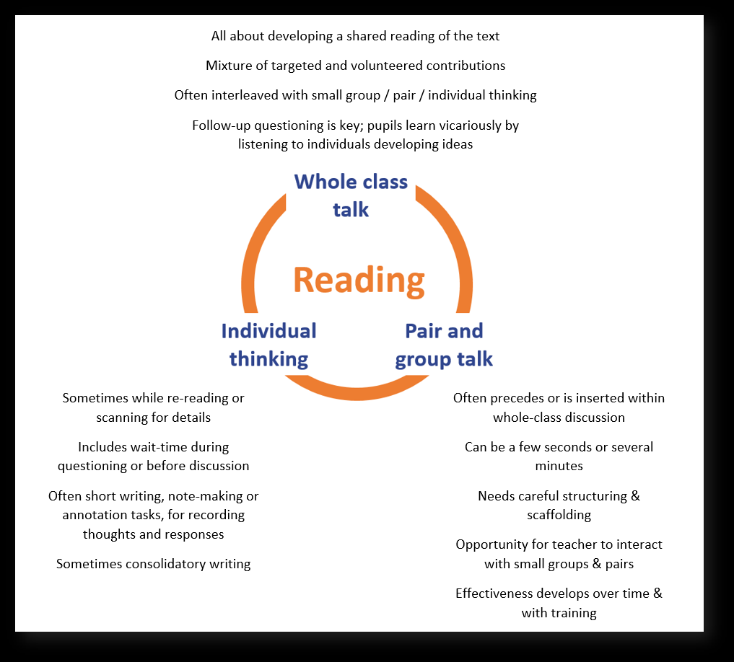

Slide 9
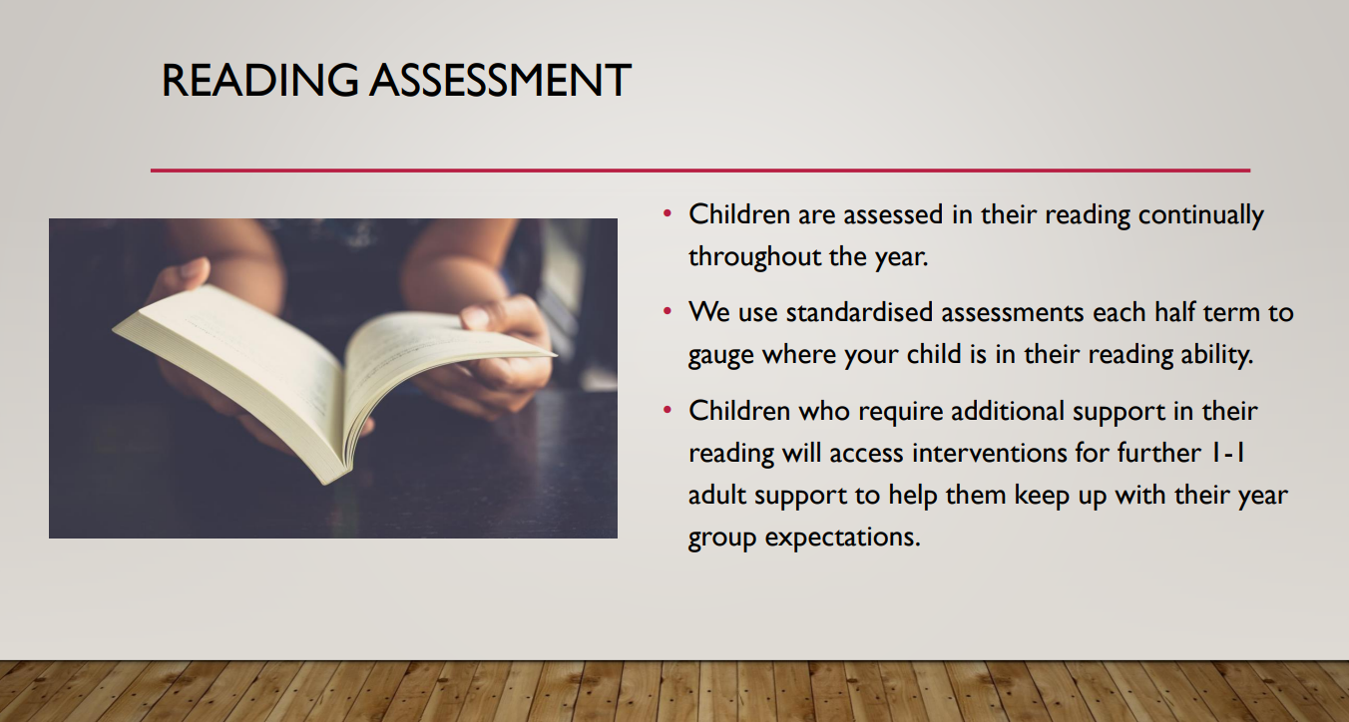

Slide 10
Whole books – not extracts!
The Fox and the Ghost King
Hansel and Gretel
The Wreck of Zanizibar
Kensuke’s Kingdom
Private Peaceful
The Boy at the Back of the Class
Indian in the Cupboard

Slide 11
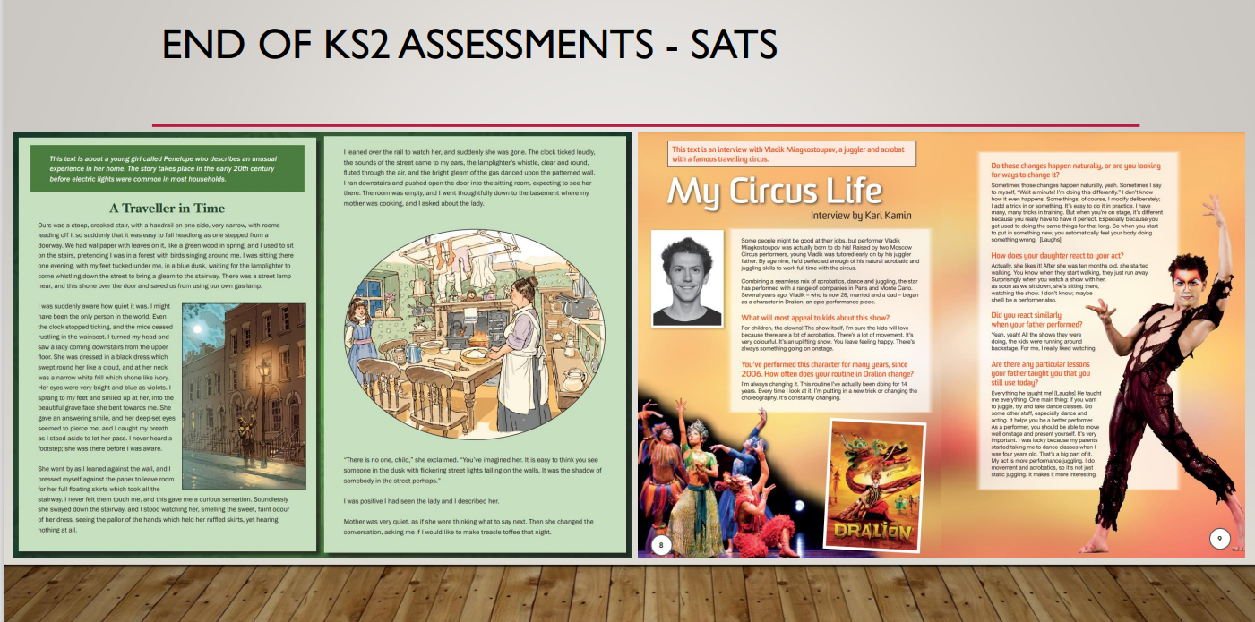

Slide 12
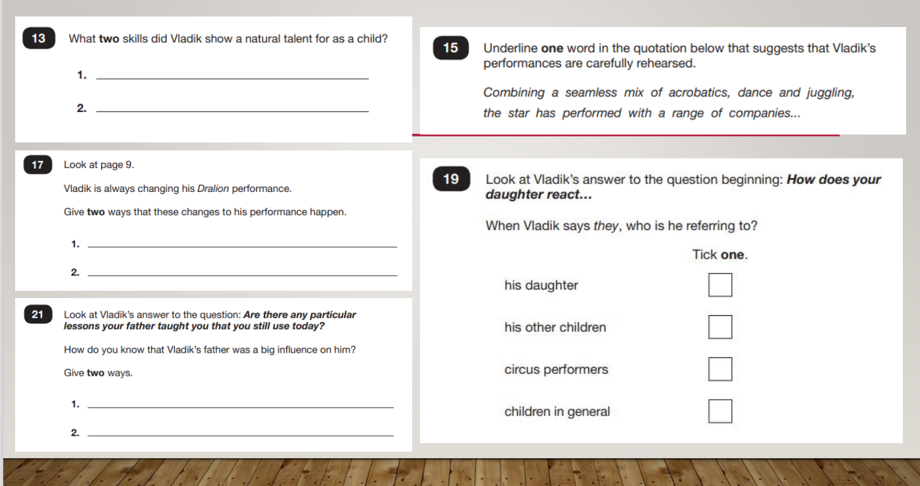

Slide 13
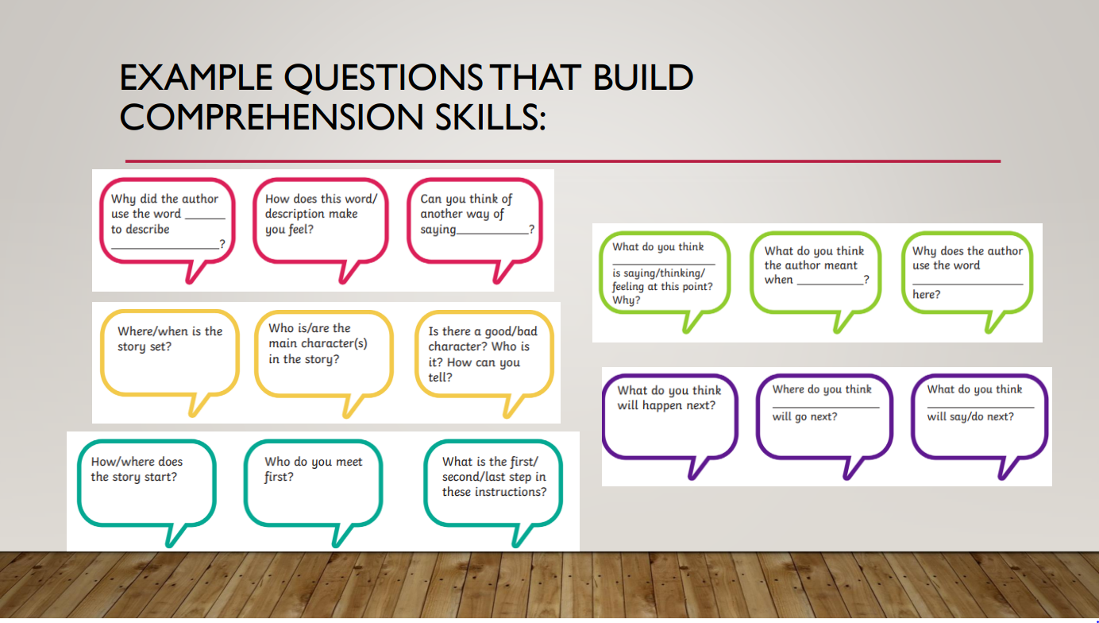

Slide 14
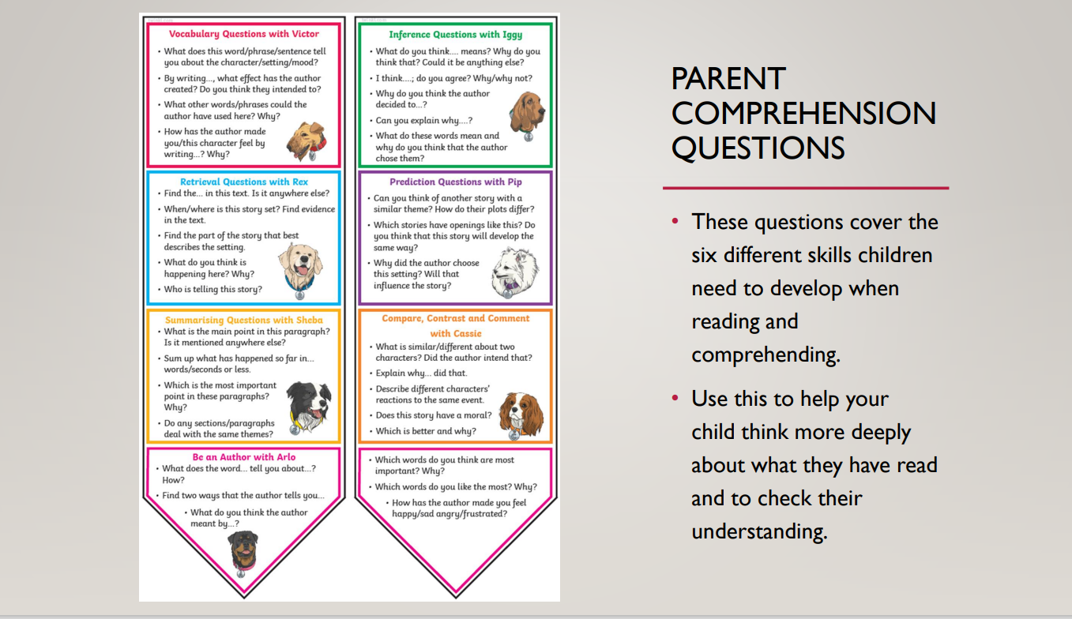

Slide 15
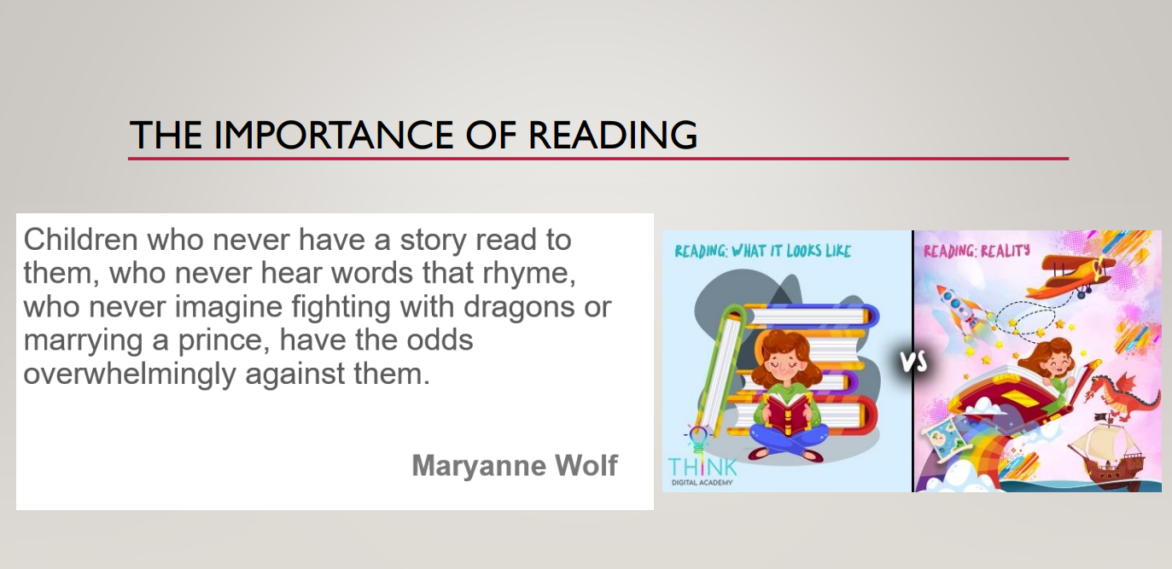

Slide 16
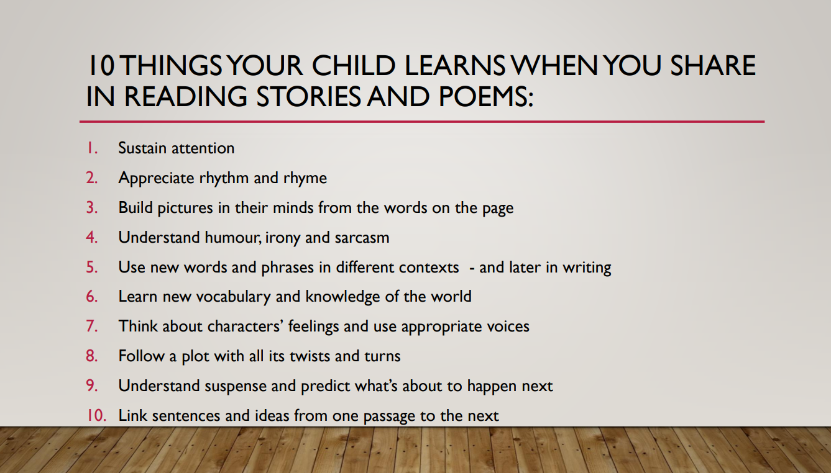

Slide 17
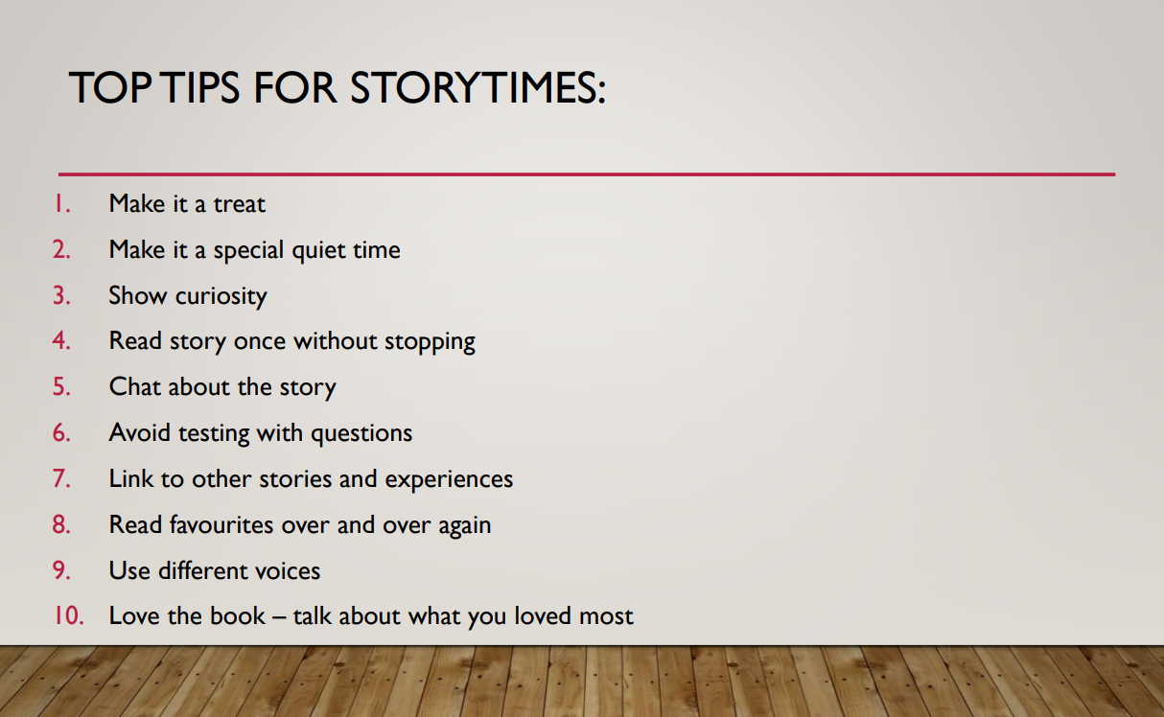

Slide 18


