Slide 1
Phonics Screening Check
Information for parents

Slide 2
Welcome
During this session you will find out:
What is the phonics screening check?
What will my child need to do?
How can parents help?

Slide 3
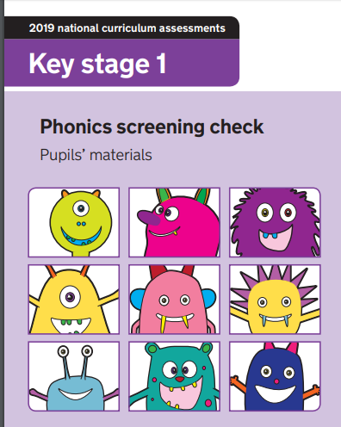
What is the phonics screening check?
The DFE say that the phonics screening check is designed to confirm whether pupils have learnt phonic decoding to an appropriate standard. It will identify pupils who need extra help to improve their decoding skills.
The check consists of 20 real words and 20 pseudo-words (we call alien words) that pupils read aloud to their teacher if they are in Y1 or Mrs Viner if they are in Year 2 in June.

Slide 4
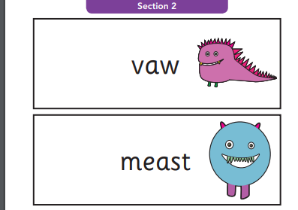
What will my child need to do?
They will read 40 words to their teacher.
The teacher will tell them if they are real or alien words (a picture reminds them too).

Slide 5
How can parents help?
Please continue to read as usual each day.
When reading encourage the children to use “special friends, Fred talk, read the word”.
CGP ‘phonics buster’ book.

Slide 6
How can parents help?
You can practise word reading:
Green words in the books that go home
Words are available on the government website from the previous checks- we have one for you today.
- Websites such as phonics play have interactive games.

Slide 7
Websites/apps that may help.
https://www.phonicsplay.co.uk/
https://www.ictgames.com/mobilePage/literacy.html
https://www.topmarks.co.uk/Search.aspx?Subject=9
http://www.letters-and-sounds.com/phase-3-games.html
https://hungrylittleminds.campaign.gov.uk/

Slide 8
Thank you for attending
Questions?

