Slide 1
Maths Parent Workshop
Upper Key Stage 2

Slide 2
How is a maths lesson structured?
Starter – The children will be given an engaging activity to do with an area for development.
Present – The children will then explore the day’s learning in a range of ways that rely heavily on children’s involvement and use of mathematical verbal reasoning. The teacher will model the new learning and the children will have a chance to practice it with support.
Apply – the children will then work through a range of tasks independently, moving from fluency tasks to reasoning and problem-solving tasks.
Review – The children will be given opportunity to review the learning, usually applying it to a problem or in a task that requires them to give a detailed explanation.

Slide 3
Year 5 Addition and subtraction
Column method​
Involves a very good knowledge of place value and number bonds to twenty​
Language for addition: carry over, sum of, altogether, more, total, plus, increase, together​
Language for subtraction: exchange (used to be known as “borrow”), difference, decrease, fewer, between, reduce, minus, take​
Same for both whole and decimal numbers
5/6 digit numbers used.

Slide 4
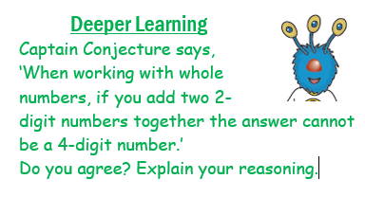
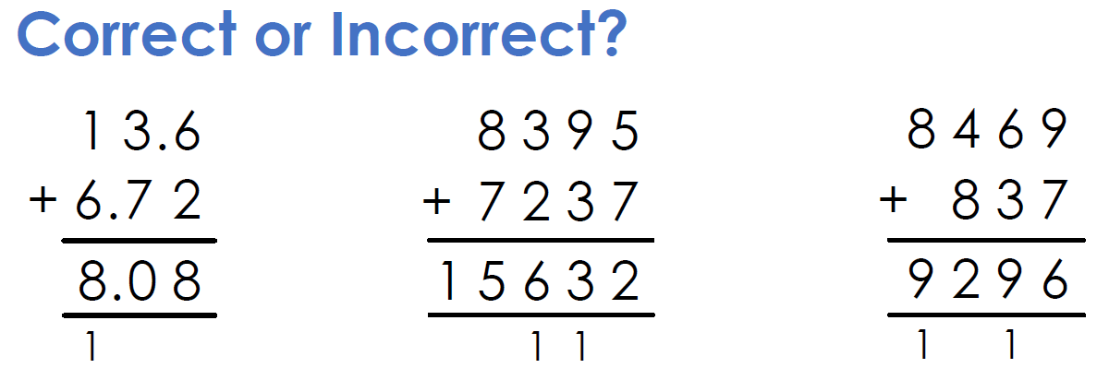
Types of questions (+ -)
FLuency
Reasoning
Problem solving
10,498 – 9,938
1,847.5 + 18,162
559.2 – 18.24
83 + ___ = 498 - 29

Slide 5
Year 6 Addition and Subtraction
Column method
Involves a very good knowledge of place value and number bonds to twenty
Language for addition: carry over, sum of, altogether, more, total, plus, increase, together
Language for subtraction: exchange (used to be known as “borrow”), difference, decrease, fewer, between, reduce, minus, take
Same for both whole and decimal numbers

Slide 6
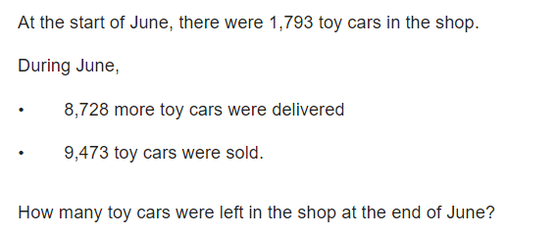
45.67 + 3.6

Slide 7
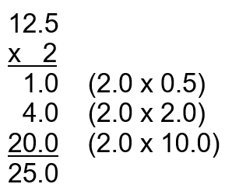
Year 5 -MULTIPLICATION
Formal column method​ (long multiplication)
4-digit by 2-digit.
Involves an excellent knowledge of times tables and number bonds to 20 (not using fingers!)​
Multiply by the ones column, then multiply by the tens column.
Language for multiplication: product, multiply, lots of, times, groups of, multiple, factors, square numbers​
Multiplication of decimals:​
Still the same method​
Teach them to “ignore” the decimal place and then include it at the end

Slide 8
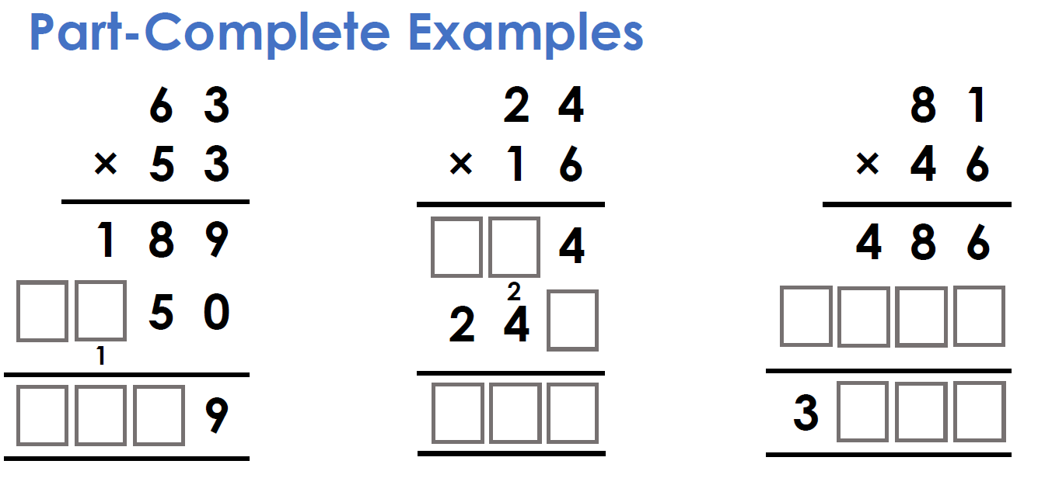
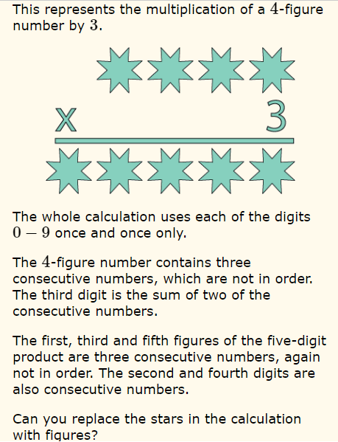
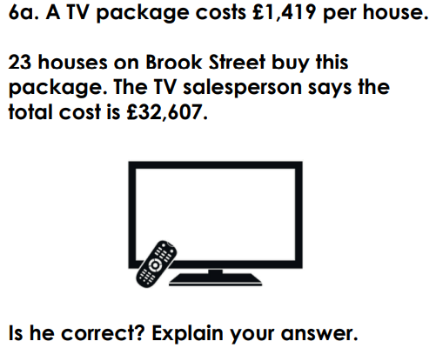
Types of questions (X)
FLuency
Reasoning
Problem solving
857 x 28
28.4 x 34

Slide 9
Year 6 Multiplication
Short multiplication
Involves an excellent knowledge of times tables and number bonds to 20 (not using fingers!)
Language for multiplication: product, multiply, lots of, times, groups of, multiple, factors, square numbers
Multiplication of decimals:
Still the same method
Teach them to “ignore” the decimal place and then include it at the end

Slide 10
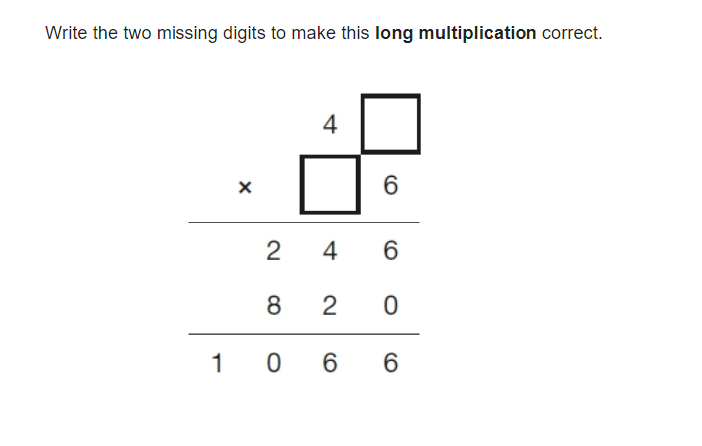
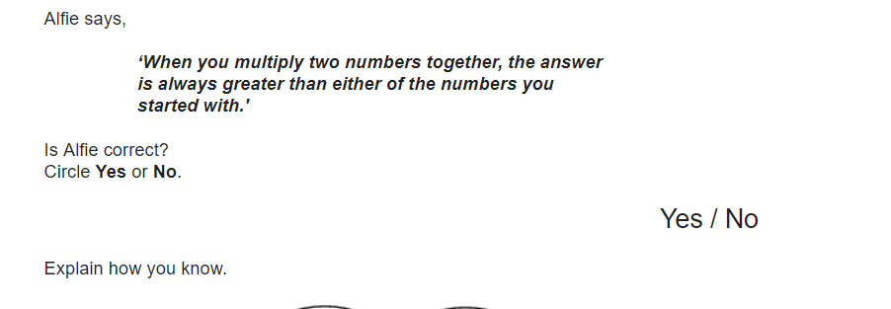

Slide 11
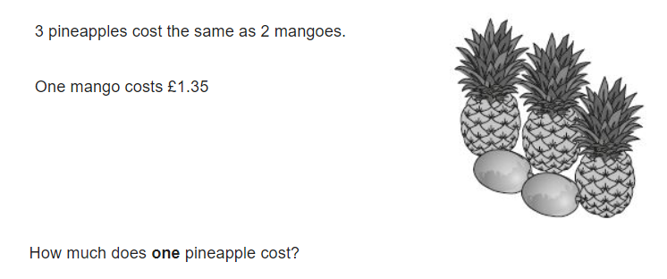

Slide 12
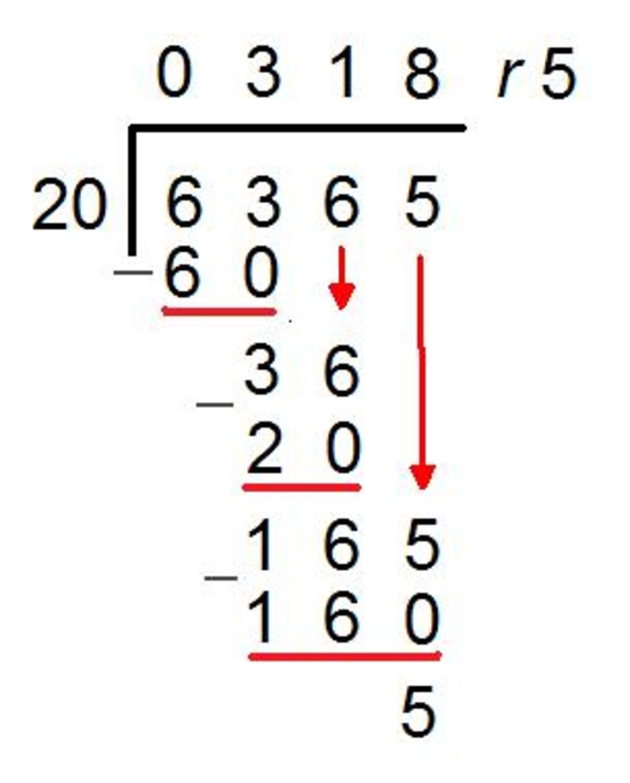
Year 5 - DIVISION
Two methods: long division (dividing by a 2-digit number) and “bus stop”​ (dividing by a 1-digit number)
Involves an excellent knowledge of times tables ​
Language for division: share equally, divisible by, divided by, group, prime numbers, factors​
“Remainders” to be presented as remainder, then fractions, then decimals ​
Division of decimals:​
Still the same method​
Knowledge of place value

Slide 13
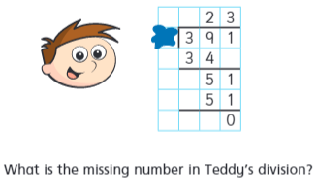
Types of questions (X)
FLuency
Reasoning
Problem solving
3841 ÷ 5
287.3 ÷ 4
3974 ÷ 14

Slide 14
Year 6 Division
Two methods: long division and “bus stop”
Involves an excellent knowledge of times tables
Language for division: share equally, divisible by, divided by, group, prime numbers, factors
“Remainders” to be presented as remainder, then fractions, then decimals
Division of decimals:
Still the same method
Knowledge of place value

Slide 15
Mathematical Terminology
Square and cube numbers
Prime numbers/composite numbers
Factors and multiples
Prime factors
BODMAS/BIDMAS
65 – 32x2 =

Slide 16
How can you help your child?
Ensure they complete SATS companion homework weekly – this is always related to the work they have done in class that week and helps them consolidate their learning.
TTRockstars – times table knowledge feeds into a huge amount of the methods we use and so it is key that children know these well.

