Slide 1
Maths Parent Workshop
Lower Key Stage 2

Slide 2
What does a maths lesson look like?
Starter – The children will be given an engaging activity to do with an area for development.
Present – The children will then explore the day’s learning in a range of ways that rely heavily on children’s involvement and use of mathematical verbal reasoning. The teacher will model the new learning and the children will have a chance to practice it with support.
Apply – the children will then work through a range of tasks independently, moving from fluency tasks to reasoning and problem-solving tasks.
Review – The children will be given opportunity to review the learning, usually applying it to a problem or in a task that requires them to give a detailed explanation.

Slide 3
Aim of the session
To explain what the National Expectations are for your child by the end of Year 3 and 4
To give you ideas and ways to support your child at home.
To understand how the four operations are taught in Year 3 and 4
To understand how you can support your child with their maths homework

Slide 4
Addition and Subtraction
To recognise the place value of each digit in a three-digit number (100s, 10s, and 1s)
Know and use number bonds to 100 and 1000
Estimate and use inverse operations to check answers to a calculation
Solve two-step addition and subtraction problems

Slide 5
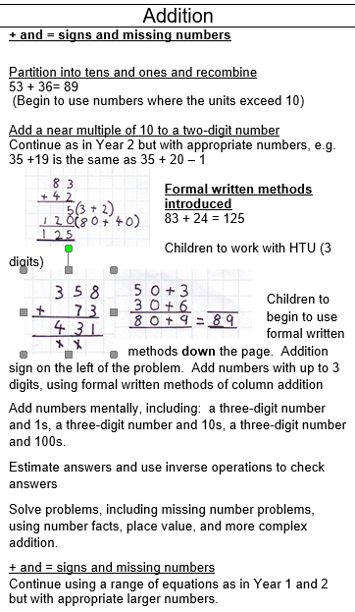
Addition
Formal method using HTO
Carrying over
Carries over to the bottom

Slide 7
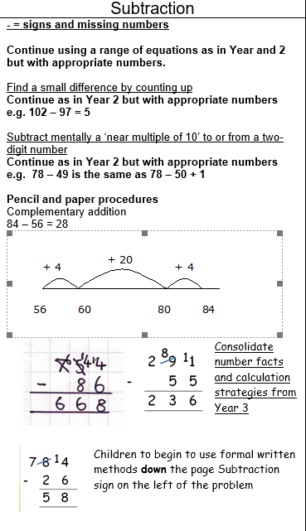
Subtraction
Formal method using HTO
Exchanging
Starting from the Ones moving towards the Hundred

Slide 8
Year 4 Addition and Subtraction
Column method
Involves a very good knowledge of place value and number bonds to twenty
Language for addition: carry over, sum of, altogether, more, total, plus, increase, together
Language for subtraction: exchange (used to be known as “borrow”), difference, decrease, fewer, between, reduce, minus, take
Same for both whole and decimal numbers

Slide 9
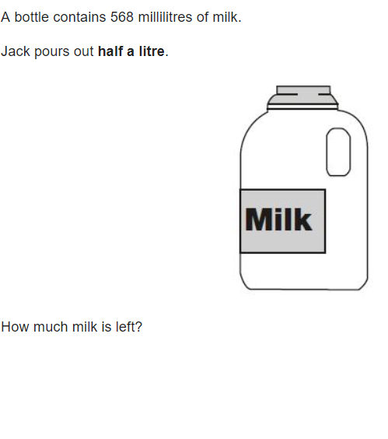
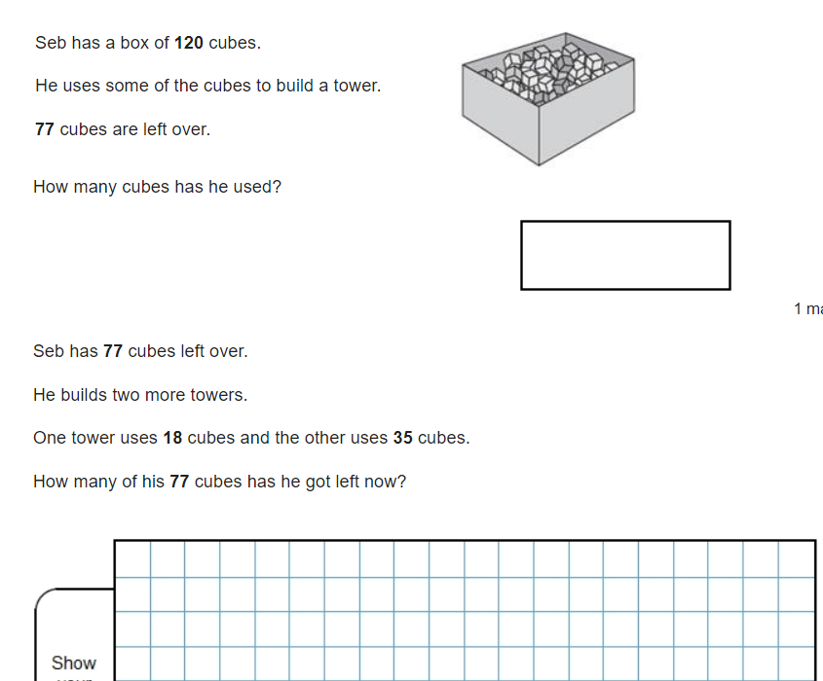

Slide 11
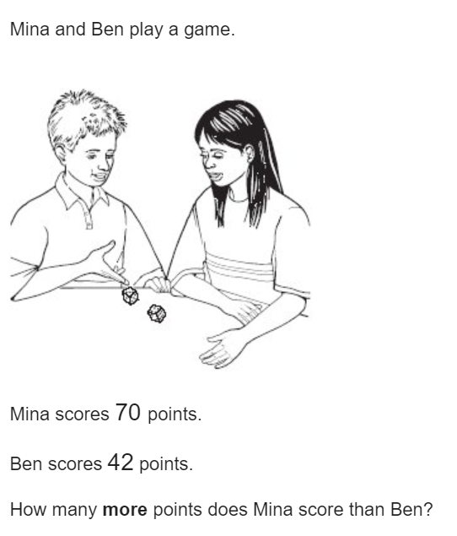

Slide 12
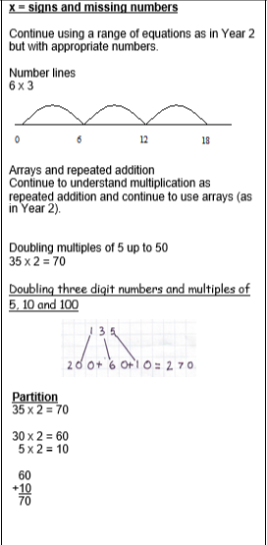
Year 3 Multiplication
Arrays and repeated addition to continue to understand the link between multiplication and addition
Partitioning method
TO x O
Recombining

Slide 13
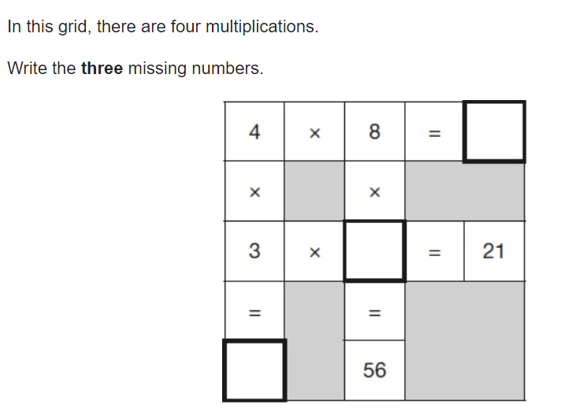

Slide 14
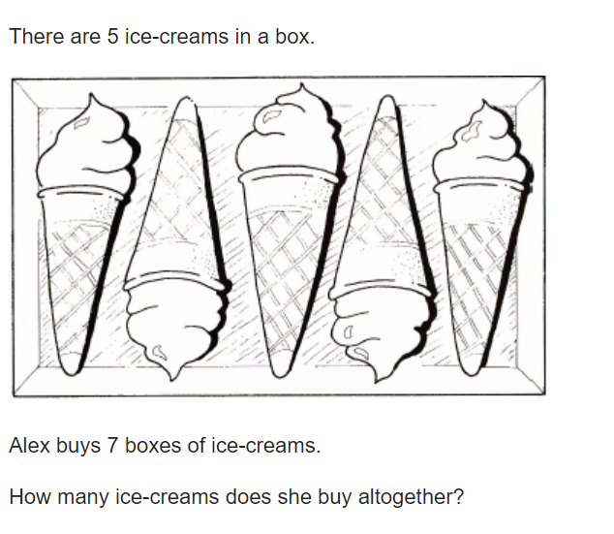

Slide 15
Year 4 Multiplication
Long Multiplication moving onto short multiplication
Involves an excellent knowledge of times tables and number bonds to 20 (not using fingers!)
Language for multiplication: product, multiply, lots of, times, groups of
Multiplication of decimals:
Still the same method
Teach them to “ignore” the decimal place and then include it at the end

Slide 16
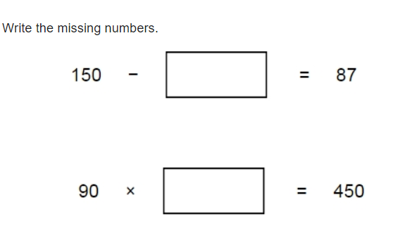
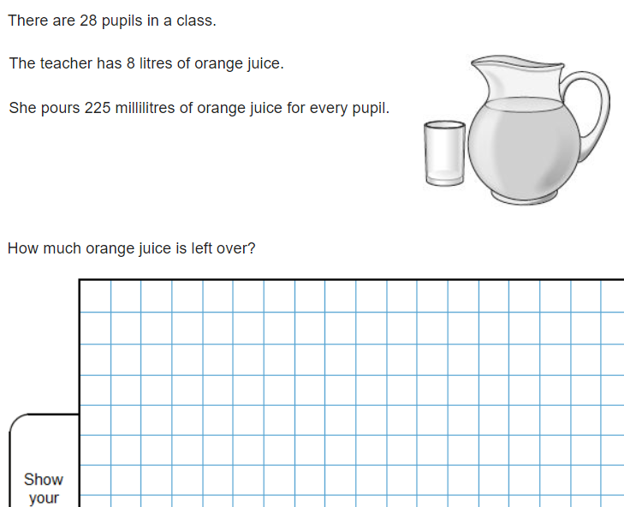
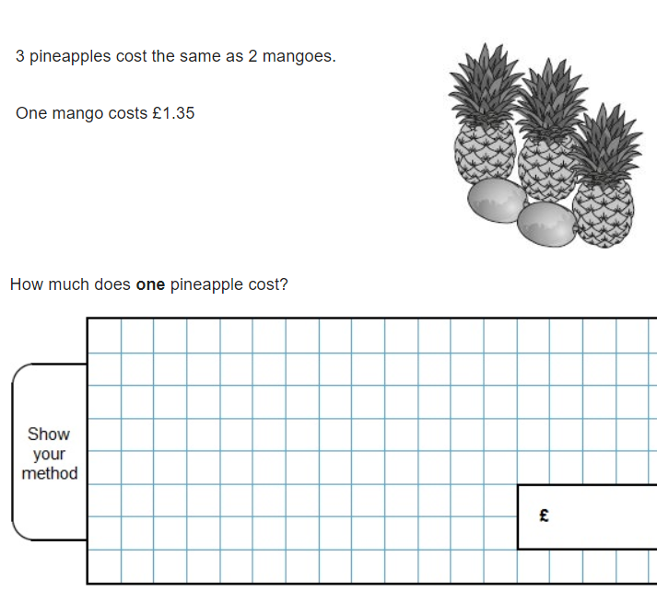

Slide 17
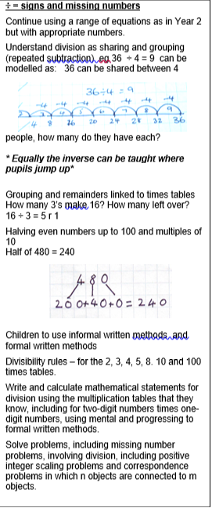
Year 3 Division
Understand division as sharing and grouping.
Use informal and written methods and formal method.
Solve problems, including missing number problems, involving division.

Slide 18
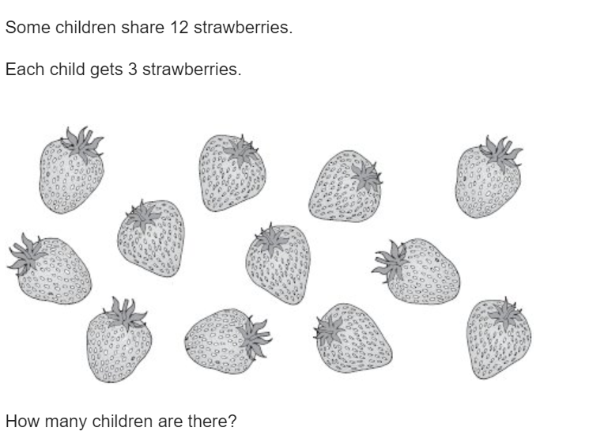

Slide 19
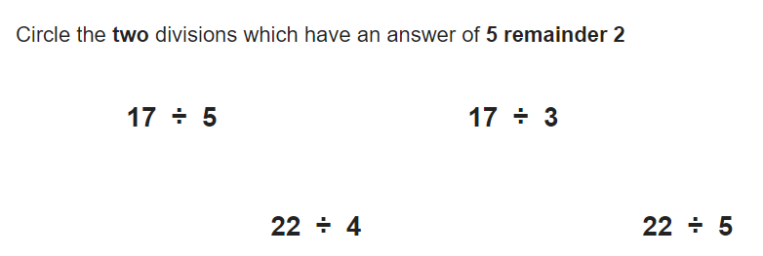

Slide 20
Year 4 Division
“bus stop”
Involves an excellent knowledge of times tables
Language for division: share equally, divisible by, divided by, group
“Remainders” to be presented as remainder, then fractions, then decimals
Division of decimals:
Still the same method
Knowledge of place value

Slide 21
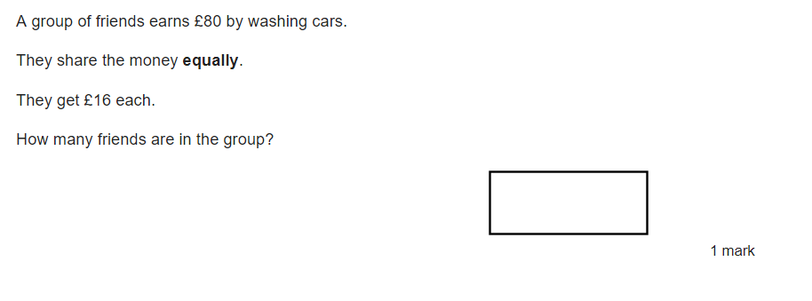
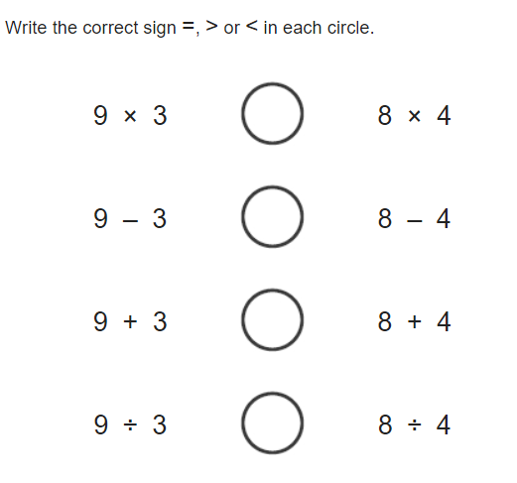

Slide 22
Year 4 Multiplication Check
To check whether pupils can recall their times tables fluently, which is essential for future success in mathematics.
Children in Year 4 will take the Multiplication Tables Check will take place during Monday 3 June 2024 – Friday 14th June.
Further information for parents: Multiplication tables check: information for parents - GOV.UK (www.gov.uk)

Slide 23
How to help at home Support weekly homework
www.ttrockstars.com
www.nrich.com
www.mathisfun.com

