Slide 1
Maths Parent Workshop
KS1

Slide 2
Aims for today
• To show you how we teach your child a variety of strategies to solve calculations and word problems.
• To give you the opportunity to use some of the equipment your child uses every day.
• To give you ideas and ways to help your child at home.
• To provide you with the chance to ask questions and chat with other parents and the teachers.

Slide 3
Year 2 - Working at the expected standard
Working at the expected standard.
• Can partition two-digit numbers into tens and units (e.g. 23 = 20 + 3)
• Add 2 two-digit numbers within 100 (e.g. 48 + 35) and can demonstrate their method
• Use estimation to check that their answer is reasonable (knowing that e.g. 48 + 35 will be less than 100)
• Subtract mentally a two-digit number from another two-digit number when there is no regrouping required (e.g. 74-33).

Slide 4
Year 2 - Working at the expected standard
• Recognise the inverse relationships between addition and subtraction and use this to check calculations and out missing number problems (e.g. ___ - 14 =28)
• Recall and use multiplication and division facts for the 2, 5 and 10 multiplication tables to solve simple problems)
• Identify 1/3, ¼, ½, 2/4, ¾
• Use different coins to make the same amount (pupils can work out how many £2 coins are needed to exchange for a £20 note)

Slide 5
Year 2 - Working at the expected standard
• Read scales in divisions of ones, twos, fives and tens where all the numbers on a scale is given (e.g. reading the temperature on a thermometer or measuring capacities using a measuring jug)
• Read the time on the clock to the nearest 15 minutes
• Describe the properties of 2-D and 3-D shapes

Slide 6
Year 2 - Working at greater depth
• Reason about addition (e.g. the sum of 3 odd • numbers will always be odd)
• Solve more complex missing number problems (e.g.14 + ___ -3 =17)
• Determine remainders given known facts (16÷5 will have a remainder of 1)
• Two step word problems
• Time-5 minute intervals
• Read scales where not all numbers on the scale are give

Slide 7
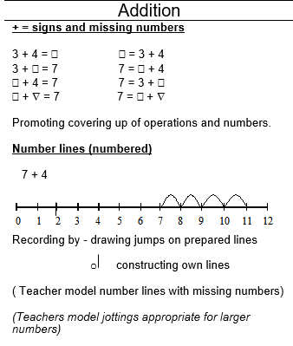
Year 1 - Addition
Teach a range of vocabulary linked to addition - add, plus, more, greater than, count on
Start by adding objects, drawing pictures to support understanding, then finally counting forward on a number line
Check understanding of the concepts that adding can be done in any order and that it is easier to put the largest number first

Slide 8
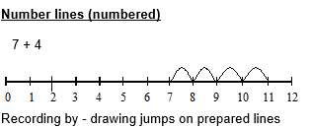
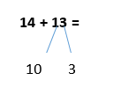
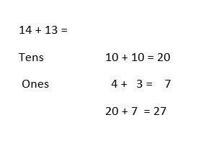
Year 2 - Addition
Number line
Children may begin using a prepared numberline but will move on to drawing their own lines. Children add U + U and TU + U and three single digit numbers.
Adding ten and 2 digit numbers on a numberline. Before the numberline is introduced, we look at the numbers visually using place value cards and deines.
Partition
The next formal method. Children partition the numbers into tens and ones and then recombine.
46 + 10 =
+10
+1
+1
+1
14
24
25
26
27
Notes:
Some children may not always get onto column or partitioning – number knowledge dependant

Slide 9
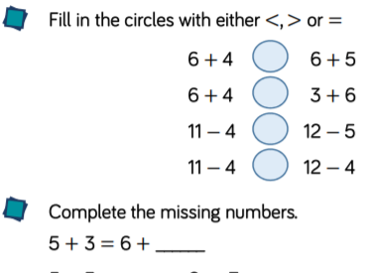
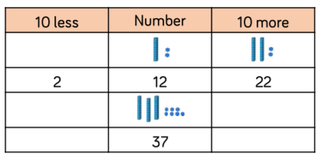
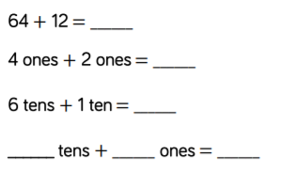
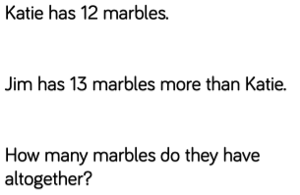
Addition Mastery/Reasoning
Notes:
Some children may not always get onto column or partitioning – number knowledge dependant

Slide 10
Year 1 – Subtraction
Teach a range of vocabulary linked to subtraction – take away, minus, fewer, less than
Start by subtracting objects, drawing pictures to support understanding
Learn how to find the difference between 2 numbers by counting up
Check understanding of the concepts that subtraction cannot be done in any order and that the answer is always smaller than the number they started with

Slide 11
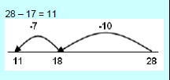
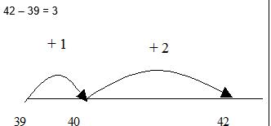
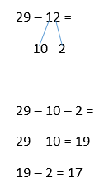
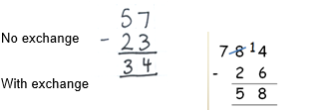
Year 2 - Subtraction
Number line
To begin with, we use the same method of counting back as the children were taught in year 1. Similar to addition but we start at the opposite end of the number line.
Counting on to find a small difference
This term the children will look at a quicker and more efficient way to subtract (by counting up). Examples of small differences are 23-21, 18 – 14, 35 – 31. The gap between these numbers are small enough to count up rather than partition and count back several times.
Partitioning Method (slight difference to adding)
Mainly to help with mental strategies. Children partition the second number only. Then they take away the tens and then the units.
Column Method
Some children may move onto this method by the end of the year.
Notes:
Some children may not always get onto column or partitioning – number knowledge dependant

Slide 12
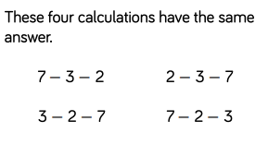
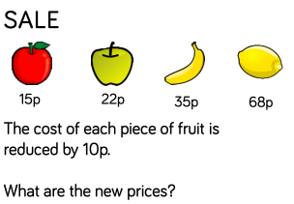
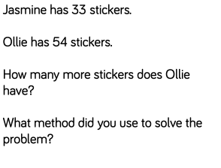
Subtraction Mastery/Reasoning
Notes:
Some children may not always get onto column or partitioning – number knowledge dependant

Slide 13
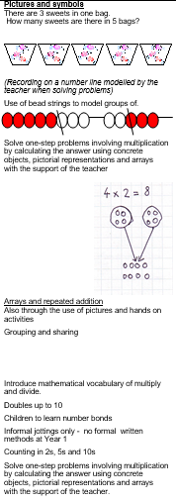
Year 1 - Multiplication
Teach a range of vocabulary linked to multiplication – times, repeated addition, lots of
Start by multiplying using objects, drawing pictures to support understanding and finally arrays
Check understanding of the concepts that multiplication can be done in any order and the difference between adding two numbers and multiplying two numbers

Slide 14
Year 1 -Multiplication
Times tables - need to learn the 2, 5 and 10 times tables
Doubles up to double 10 by heart

Slide 15
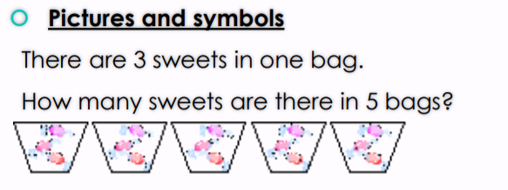
Year 2 - Multiplication
For all these methods we encourage children to count in the number that is being multiplied (eg, 2s, 3s, 5s, or 10s). Key vocab – lots of, groups of, multiply, times.
Repeated Addition
Children will write multiplication calculations for given repeated addition calculations and vice versa.
Arrays
A useful way to also explore that order in multiplication does not matter.
Grouping/Pictures and Symbols

Slide 16
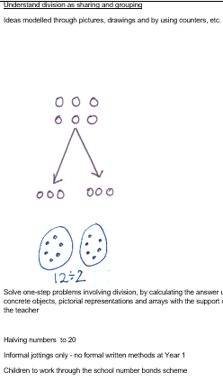
Year 1 - Division
Teach a range of vocabulary linked to division - divide, share, group
Start by sharing and grouping objects, drawing pictures to support understanding
Link to halving
Check understanding of the concepts that division cannot be done in any order and that all groups have to be equal

Slide 17
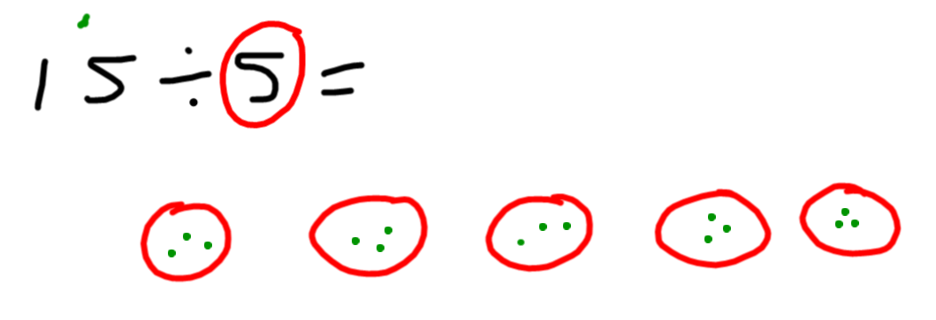
Year 2 - Division
Understand division as sharing and grouping. They learn this first through visuals and we tend to relate division to share of sweets or objects to help with the concept.
Grouping/Pictures and Symbols
Grouping
Children are then taught to draw their own groups and share out the dots (number) equally into each group. It is important children understand that each group must equal.

Slide 18
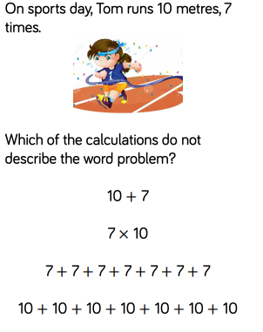
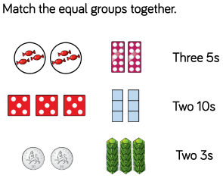
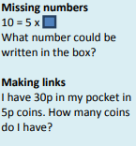
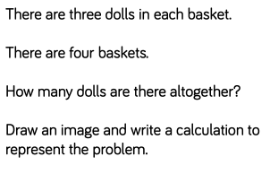
Multiplication and Division Mastery/Reasoning
Notes:
Some children may not always get onto column or partitioning – number knowledge dependant

Slide 19
Things to remember
At home, you can aid your child by using the following:
Practising number bonds
Practising addition and subtractions facts
Practising multiplication facts for the 2, 3, 5 and 10 times tables
Talking about maths in real life situations – language is a key part of your child’s understanding

